Slide 1
SpiraTeam Nuts & Bolts Gone in 30 minutes
Agile Training Champions
Sriram Rajagopalan

Slide 2
Images are property of copyrighted owners

Slide 3
Framework of (dis)agreement
Waterfall
Requirements
Activities
Deployment
Testing
Agile
User Stories
Tasks
Releases and Iterations
Acceptance Test
Images are property of copyrighted owners

Slide 4
Let us get Grounded
SpiraTeam | Scrum
Requirement | User Story
Task | Task
Release | Release
Iteration | Iteration
Test Case | Acceptance Test
Images are property of copyrighted owners

Slide 5
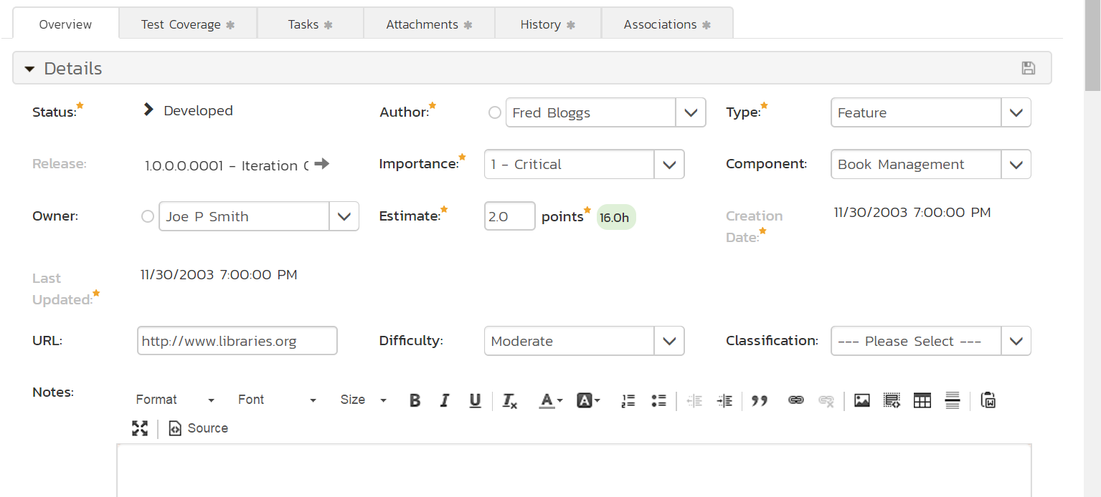

Slide 6
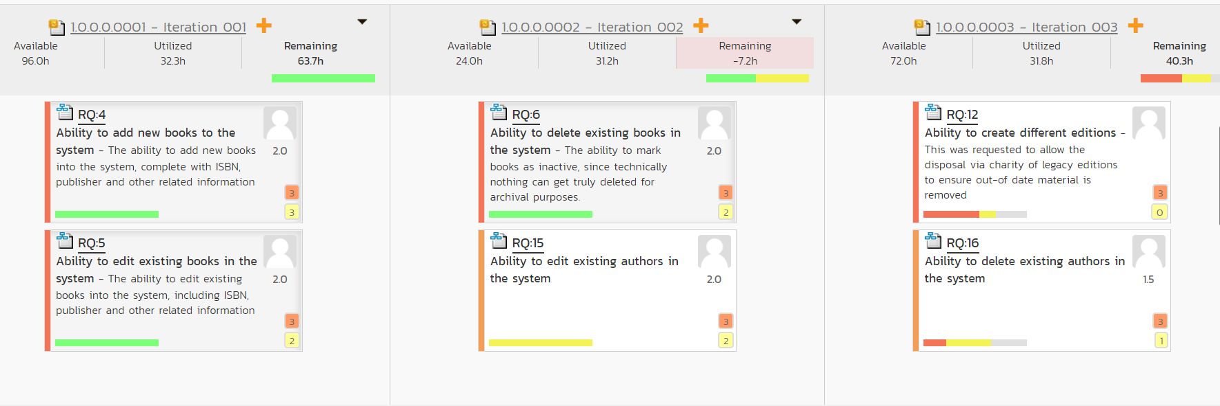

Slide 7
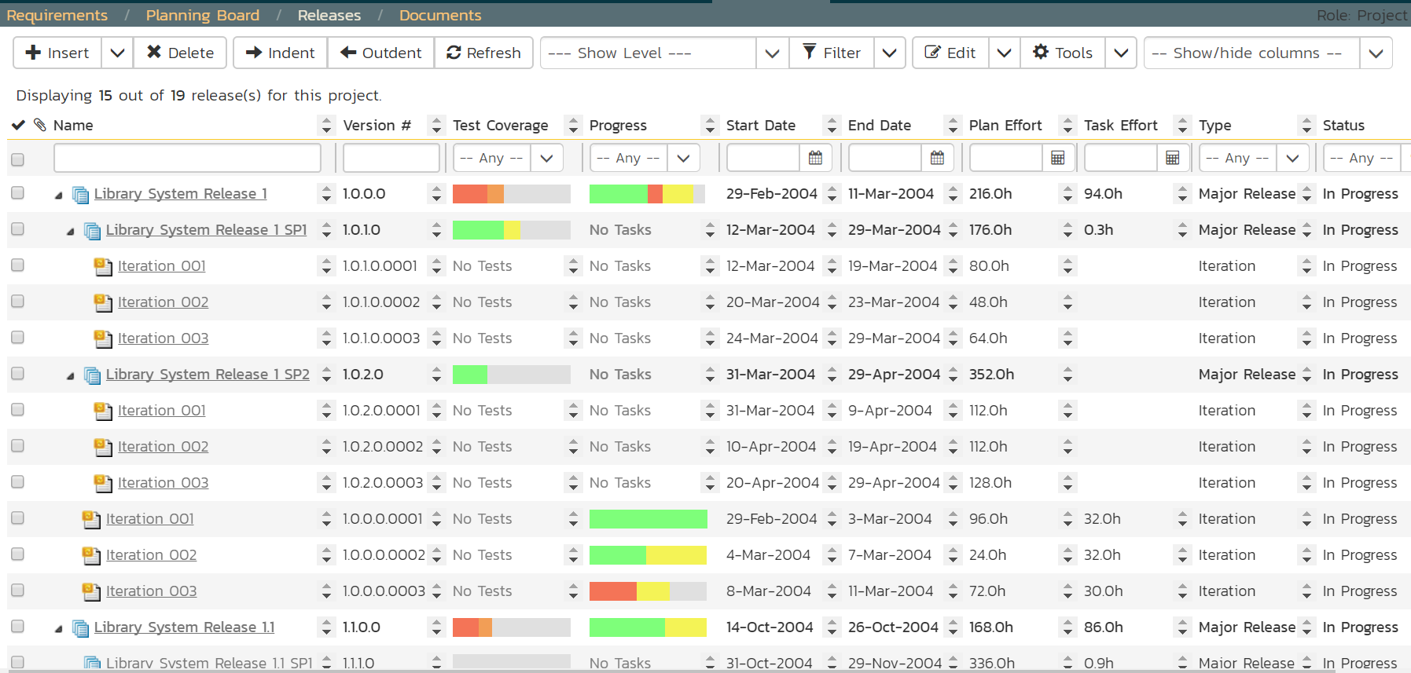

Slide 8
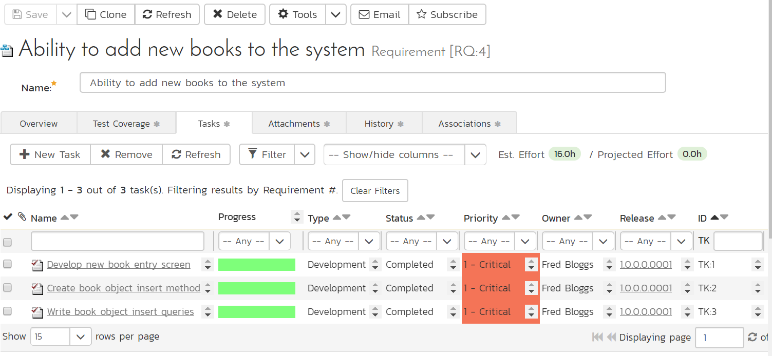

Slide 9
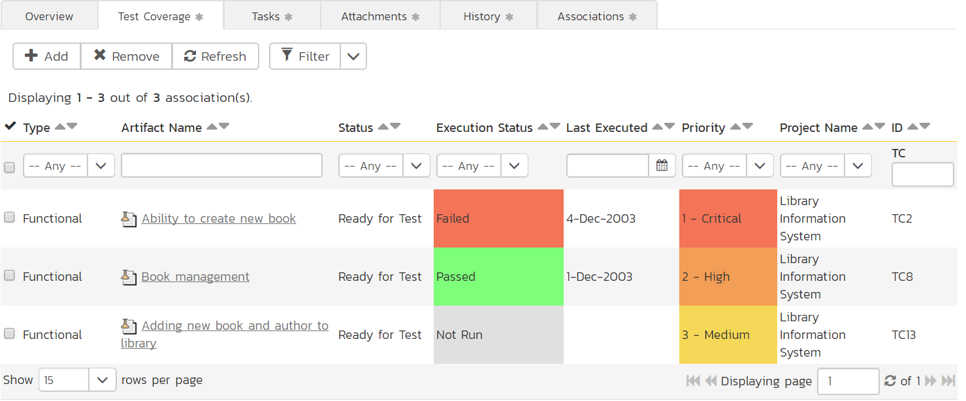

Slide 10
Lessons Learned
Setup user roles and privileges
Establish the user story / requirements process
Estimation
Prioritization
Empower test case development to requirements traceability
Ensure a discipline around task configuration
Links to SharePoint, due dates, group/individual ownership
Establish a task workflow
Establish test defect workflow

Slide 11
Summary
SpiraTeam is framework agnostic
SpiraTeam is framework friendly
SpiraTeam is one-stop ALM tool
For more information, please contact Sriram Rajagopalan, Agile Training Champions

